Slide 1



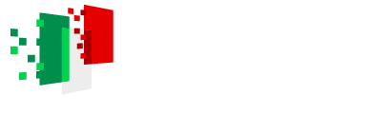
ETICHETTE PER INVENTARIO
PNRR - M4 C2 – IR0000012
PNRR - M4 C2 – IR0000012
PNRR - M4 C2 – IR0000012
CUP: C53C22000430006
CUP: C53C22000430006
CUP: C53C22000430006
Dimensione: 5x2 cm
Dimensione: 8x2 cm
Dimensione: 7x5 cm

